Slide 1
WELCOME

Slide 2
Agenda
3 – 5 P.M.
Introductions
NCR – Brian McGlinchey – Account Executive
NCR – Jackie Barbanente – Vice President, NCR VOYNIX
Working Relationship
Professional Services Contract
Utilization hours
Availability to move PS hours to following year
SOW generation ( all projects )
Project Manager Onboard
Supply Chain Solutions Update by Product Updates / Roadmap
CRM Suite
Power Enterprise
Power Warehouse
Power Dock
Power Yard
Power Transportation

Slide 3
r
NCR Voyix Supply Chain Solutions
We run the supply chain for wholesalers and distributors
run the supply chain
4,300
7-10M
227⁺K
trucks dispatched each day
cases received into warehouses each day
warehouse orders placed each day
With 30+ years sustained results (formerly Retalix USA)
Notes:
At NCR, we run the entire supply chain for leading food and foodservice distributors
Grocery & c-store wholesalers
Grocery & C-store self-distributing retailers
Foodservice suppliers – broadline distributors, specialty food distributors
We have solutions that solve for every step
Ordering from vendors (growers/manufacturers)
Inbound and outbound transportation
Warehouse operations
Moving goods in and out of the warehouse,
Customer relationship management
Order management, CRM tools
Enterprise systems that manage all the data and integrations in-between

Slide 4
NCR Voyix Business Enterprise Management
Solution Components
Supplier Management
Operations Management
Customer Management
PO collaboration
Vendor income tracking
Demand forecasting & purchasing
Inventory management
End to end traceability
Warehouse/Transportation
Order guides & contracts
Order mgmt. & billing
Customer rebate mgmt.
Operational Financials | Master Data Management | Analytics & Reporting
A/R, A/P, G/L integration
Vendor funds management
Financial reporting
Item master & pricing
Customer & vendor master
Data governance tools
KPI tracking and reporting
User-defined dashboards
Real time data visibility

Slide 5
Enterprise Business Management
The backbone of our supply chain suite
Master data management
Built-in data governance tools
Order management & billing
Operations & logistics
Basic warehouse processing
Integrated business financials
Business intelligence
Notes:
Power Enterprise ties it all together, giving you the tools you need to operate every aspect of the business.
These are just a few of the main areas that we support –
Our solution supports all the other components of our supply chain so that you can gain transparency, accuracy and efficiency across your distribution network.

Slide 6
Power Enterprise Release 8.2
New User Interface
Improved 3rd party application connectivity thru Web services
Improve & enhance interfaces with 3rd Party applications.
Data Tracking
Add Graphic Analysis
Improve EDI capabilities.
Improved Day end functionality & recovery experience
Split Orders by Truck/Container Weight-Cube
Allocation of Item Reserve Qty in Order Entry
Improve Assorted Reporting
Notes:
Flexibility
WordPress
Loyalty
Earn and Burn
Partner that can talk about trends
Google Search
Mobile Shopper
MFC Integration
Fulfillment / ShopperKit / Walkpath
ShopperKit or Our Solution
Four-tiered pricing
Clickable circular and Recipes
Be able to add all items or individual items
CC: Older demo, bots with fraud happening recently
What is your ecomm strategy? To Provide additional services/ shopping options for their customers? Increase sales? Differentiate against competition?
What are your priorities?
What’s driving the consideration for change? – call in service with Rosie that it wasn’t built to do and with the new platform they won’t be able to use it, truck fleet & their costs associated with – not going to be supported by Rosie. Still deciding if they will continue to use the call in service. One person manages the trucks and drivers, looking at fleet management software – 6 trucks
What is the most challenging with your current solution?
What would you like to see in a new solution? Ease of use, accounting will be a huge factor on the back-end,
Full site vs just a shop dot

Slide 7
Power Mobile
Rewrite of application
modern look
Improve performance
Explore Partnerships
Ability to Make Payments
Where’s My Truck functionality.
Support for Tomcat 10 and OpenJDK 21

Slide 8
Power Net
Redesign to give it a more modern look and feel.
Move away from Stored Procedures and use API’s.
Will help with better performance.
Synonym Search (Search for Chicken, Chick, Chx, etc.)
Display COOL Codes on the Email Confirmation
Where’s My Truck functionality.
Cutoff Times by week in advance (PE 8.1 logic that should follow down to Power Net)
Alerts when Power Net subsystem or one of its jobs isn’t running.
Ability to have more than one item image attached to an item.
Support for Tomcat 10

Slide 9
Power Sell
Support for Windows 11
Email support using connections to Office 365
Support for Firebird 4 and 5 to help with performance
Better logging to help with troubleshooting of issues

Slide 10
Power Menu
Healthcare features
POS integration
Migration tool for converting users from Power Menu to Power+ Menu

Slide 11
Power Warehouse 7.3
NCR’s Warehouse Management Solution help increase warehouse service levels while lowering costs, by completely automating location and task management utilizing wireless RF and voice-activated technology.
Receiving
Put-away
Inventory Management
Picking
Truck Building & Shipping
RF Receiving Labels On Demand.
HACCP – Entry / Reporting
Item / Pallet Receiving
Improved Receiving Screen
Unslotted Items Expected Quantities
On demand OSD / Notes
Improved Forklift Menus
Real-time destinations based on defined variables and needs
Temp Control / Locks soft or hard warning.
Cycle count recounts now include all pallets.
View cycle counts item's variance / Ability to adjust
Negative slot report by detail or summary
Counts sheets for Pallets on Hold
Adjust Cycle Count reason codes.
Adjust Pick Slots with RF Access
RF Counts Sheets
New Voice task through Dev Kit. and pick methods
Containerization, value-add processing and kitting
Ability to manually assign a selector to a UOW.
Selector Types / Customer Types
Expanded RF Loading Screens
Special Pick – For a Replen to an alternative Pick location

Slide 12
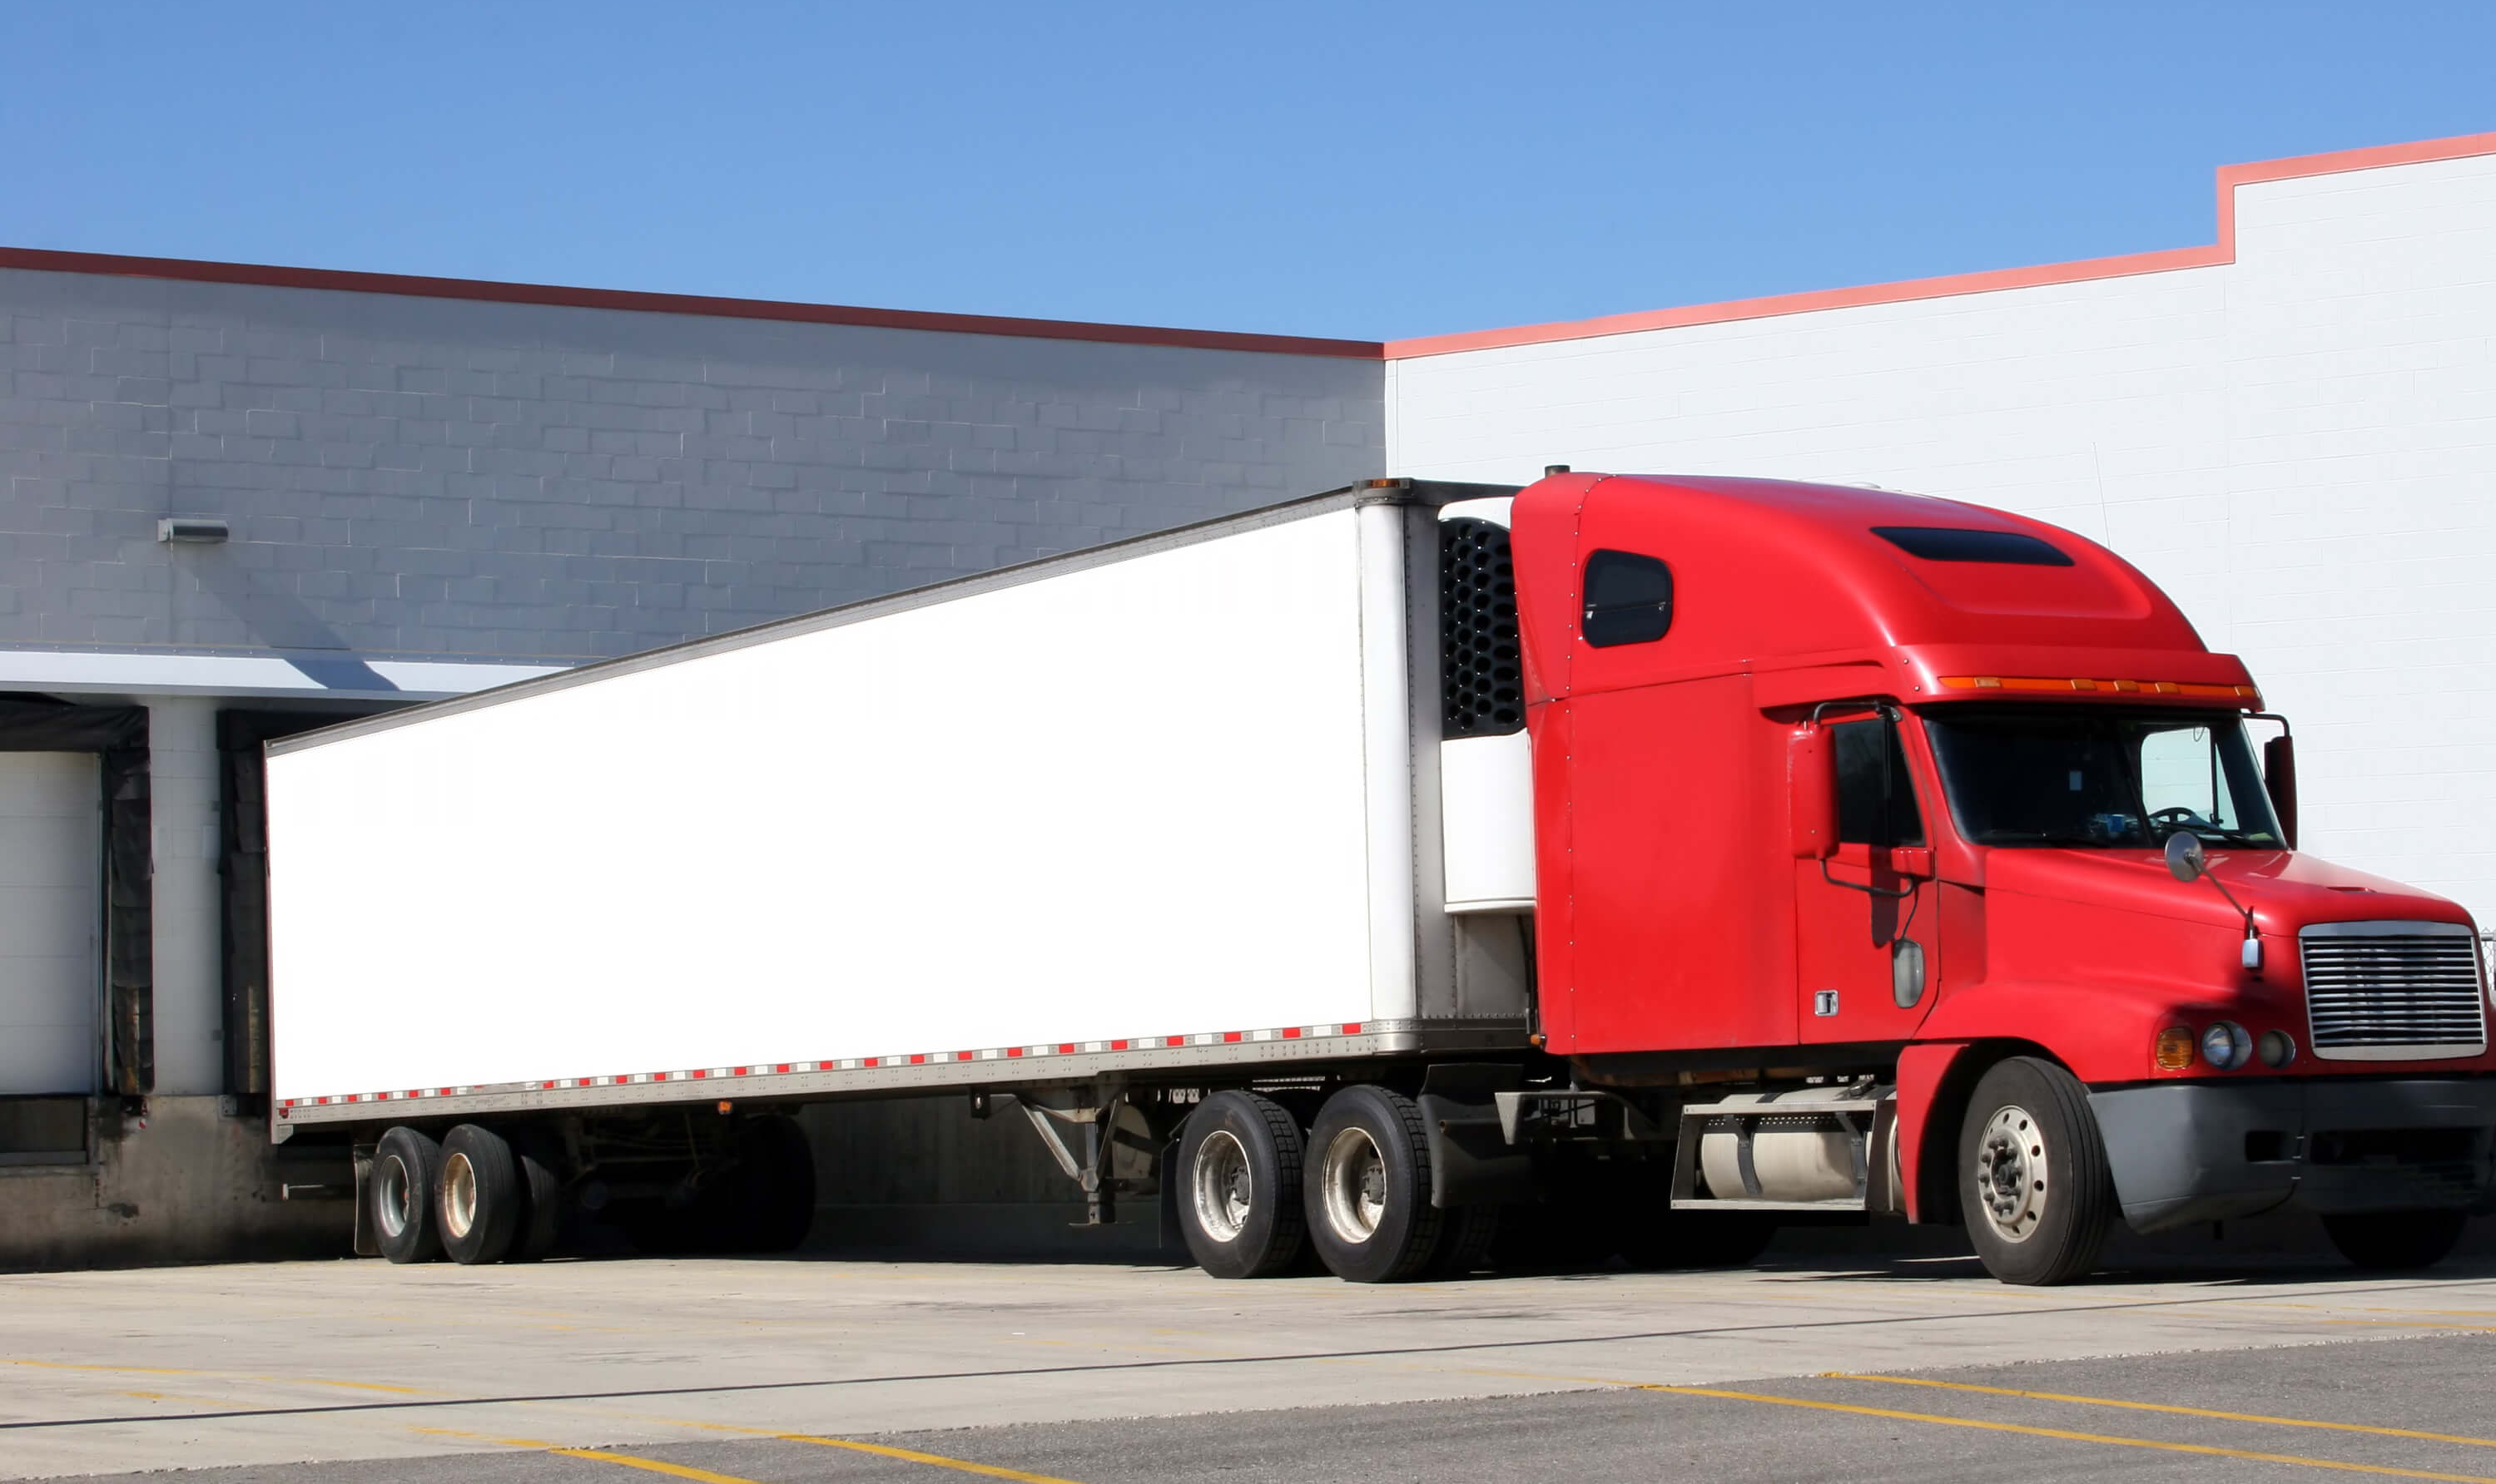
Transportation Management
Reducing miles driven, improving profitability, and ensuring accuracy
Dock scheduling
Yard management
ROUTING OPTIMIZATION
Proof of delivery
Centralizes dock Schedules
QRF Driving Check In, PO, Contact information
Improved Communication through Text Messaging
Improved capacity planning by Trailor door
Improved KPI for Jockey Dashboard – Moves er hour
QRF – Driver Check In
Improved Communication through test messaging
Working on Collaboration with UniPro to develop a new roadmap for PTO.
Simplifies the reconciliation of Products, Paperwork and Payments through the last mile of the supply chain.
FSMA Tracking / Developed and in production.
Improved Efficiency
Online Planning
Reduced Labor
Labor Productivity
Inventory Visibility
Real-time Tracking
Faster Delivery
Reduced Costs
Better Collaboration
Less Paperwork
Fewer Errors
Happy Customers
Notes:
Dock scheduling:
Every second counts – that’s why we help make sure you have all the right resources to manage deliveries and pickups across every dock
Suppliers and carriers book their own appointments online
Your labor needs are forecasted so you have the resources to load and unload
Business intelligence provides continuous improvement to keep you at capacity without ever being over
Yard Mgmt
We see your yard is an extension of the warehouse, with all the same inventory visibility and slotting requirements
We help automate yard management
streamline day-to-day operations
Increase productivity
Eliminate operational silos
This means you can achieve
Just in time shipping
Optimized yard slotting and trailer management
Enterprise-wide visibility into inventory
to partner compliance and performance
TMS
Getting orders to your customers needs to happen in hours, not weeks.
Dynamic route optimization to
Maximize inbound profitability
Minimize outbound expense
Online tool for carrier collaboration (bidding, confirmation, invoicing)
Simplifies the complexity of foodservice distribution
Load building
Order splitting
Backhaul optimization
Helps identify new income opportunities
POD
Reconciles the products, paperwork and payments across the last mile
inventory management until the customer signs
Routing to customers
Scheduled pickups and deliveries
Item scanning upon delivery
Electronic signature capture
Customer service on the go
Invoice adjustments
Delivery receipts
Collect payments
Variance reports

Slide 13
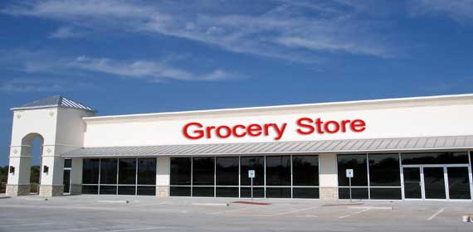
Product Traceability
Suppliers
Distribution & Retail
Customers
Lot #
GTIN
Sell By / Serve By
Temperature
COOL
Tracking throughout the Supply Chain cycle
Working in close collaboration with industry experts and our customers, we designed our systems to ensure both compliance and usability, providing you with an end-to-end traceability solution.

